Slide 1
Mass spectrometric analysis of proteins using Electron Transfer Dissociation
Frederik Lermyte^{(1,3)}, Dirk Valkenborg^{(2,3)}, Frank Sobott^{(1,3)} ¹Department of Chemistry, Biomolecular Mass Spectrometry, University of Antwerp, Antwerp, Belgium ²Flemish Institute for Technological Research (VITO), Mol , Belgium ³Center for Proteomics (CFP-CeProMa), University of Antwerp, Antwerp, Belgium
BIOMOLECULAR MASS SPECTROMETRY group

Slide 2
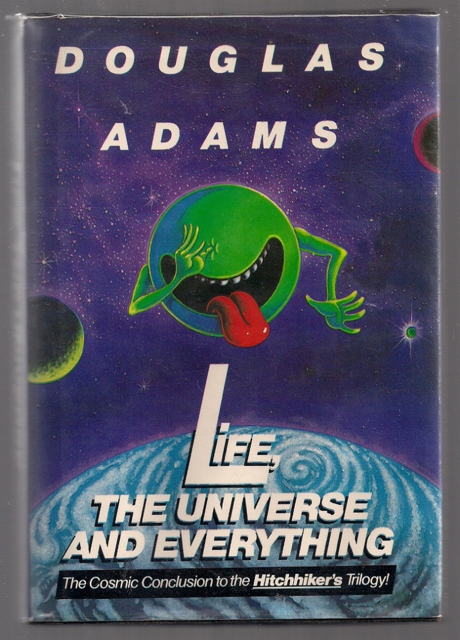
Introduction

Slide 3
Overview
Biochemistry recap
Central dogma
Protein structure
Mass spectrometry
Bottom-up vs. top-down
Native vs. denatured
Electron transfer dissociation (ETD)
Case study: alcohol dehydrogenase
Effect of ETD on isotopic distribution (bioinformatics)

Slide 4
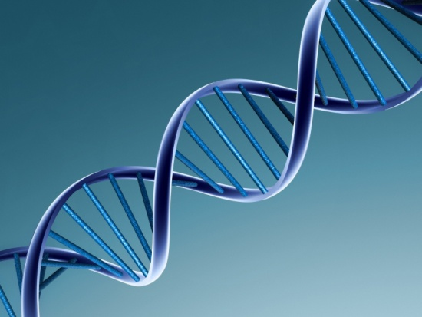
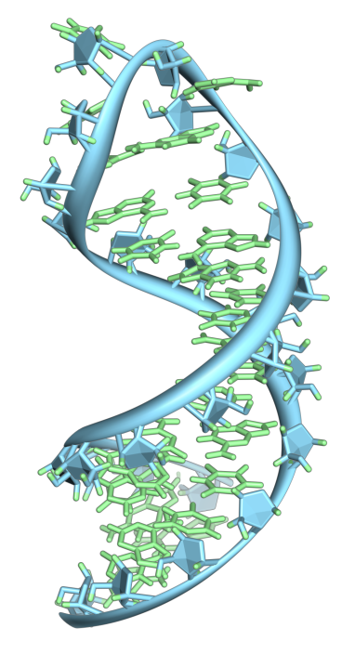
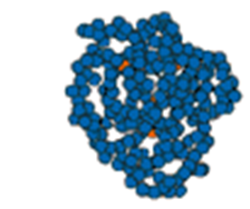
Basic biochemistry
DNA
mRNA
Protein
Transcription
Translation
Genome
Transcriptome
Proteome
Fraser, C.M. et al.: The minimal gene complement of Mycoplasma genitalium. Science 270(5235), 397-404 (1995)
Adams, M.D. et al.: The genome sequence of Drosophila melanogaster. Science 287(5461), 2185-2195 (2000)
Lander, E. S. et al.: Initial sequencing and analysis of the human genome. Nature, 409(6822), 860-921 (2001)
Venter, J. C. et al.: The sequence of the human genome. Science, 291(5507), 1304-1351 (2001)
Venter, J.C.: A Part of the Human Genome Sequence. Science, 299(5610), 1183-1184 (2003)

Slide 5
Basic biochemistry – information content
Proteome
>10⁸
Transcriptome
>10⁶
Genome
2,3x10⁴

Slide 6
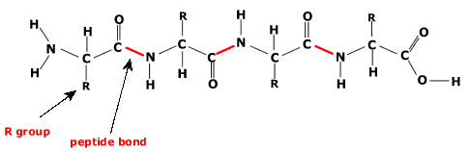
Protein structure
(Large) linear polymer (chain) of amino acids
Protein = amino acid sequence
+ post-translational modifications (PTMs)
+ 3D structure
+ protein-protein/protein-ligand complexes
How do we analyze this?
(20)
→ Mass spectrometry!

Slide 7
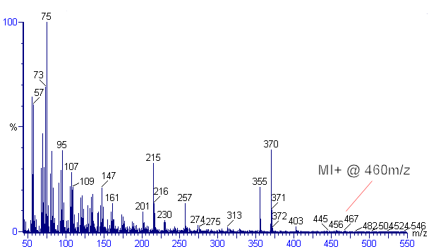
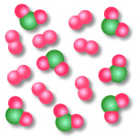
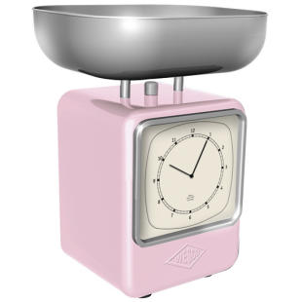


Mass spectrometry
H⁺ = proton (‘handle’ on molecule)
-H⁺
-H⁺
-H⁺
-H⁺
-H⁺
-H⁺
-H⁺
-H⁺
-H⁺
: (m/z, ~ # )
: (m/z, ~ # )

Slide 8
Charge state distributions
Number of protons (charges) placed on protein is not a single value, but a distribution!
e.g. ubiquitin (76 amino acids, 8.6 kDa ):

Slide 9
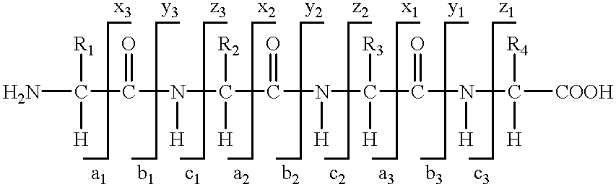
Tandem mass spectrometry
[CH₃-CH₂-OH + H⁺]
m/z = 46.07 Th
C₂H₆O
[CH₃-O-CH₃ + H⁺]
m/z = 46.07 Th
C₂H₆O
- H₂O
- CH₃OH
Mass analysis: vacuum
Collision-induced dissociation (CID): let ions collide with inert gas molecules
Internal energy increases
Weakest bond(s) break
Mass of precursor and fragments reveal molecular structure

Slide 10
Tandem mass spectrometry
Ion source
Fragmentation
cell
MS1
MS2
Detector
Gas-phase ions
Precursor m/z isolated
Fragments generated
m/z scanned
Spectrum generated

Slide 11
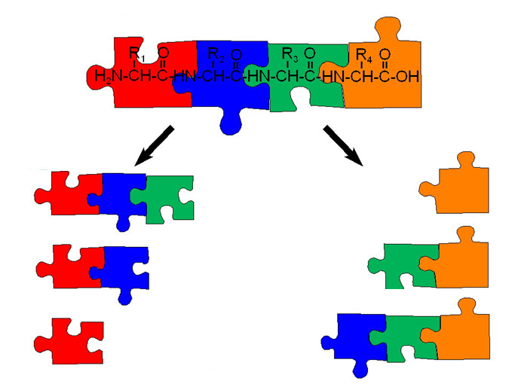
Tandem mass spectrometry
Theory: ΔM → amino acid sequence
Practice: internal energy buildup → side reactions
e.g. loss of PTMs, protein complexes, ligands, etc.

Slide 12
CID side reactions

Slide 13
CID side reactions

Slide 14
CID side reactions

Slide 15
CID side reactions

Slide 16
Bottom-up/top-down
Protein
Denature
(lose 3D)
Separate (LC)
Digest (cut into peptides)
MS/MS
Separate (LC)
Simple data
CID side reactions still a problem!
MS/MS
Complex data

Slide 17
Native/denatured proteins
Native: keep 3D structure (including complexes) intact
Why?
Study protein conformations
Study protein/protein or protein/ligand interactions directly
How?
Solution phase: no acids/organic solvents
Ionization: ‘soft’ methods (electrospray ionization/ESI)
Careful control of voltages/pressures in gas phase (minimal internal energy buildup)
Can we still perform fragmentation?

Slide 18
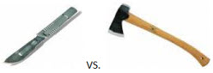
Electron capture/transfer dissociation
CID: gradually increase internal energy by 10³ collisions
ECD/ETD: H⁺ + e⁻ → H. (radical causes fragmentation)
Advantage: very specific reaction → minimal side reactions
Also: limited preference for certain residues (exception: proline)
ETD
CID

Slide 19
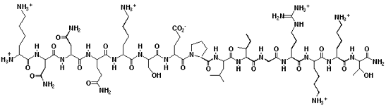
Electron capture/transfer dissociation
Proline:
Difference ECD/ETD: source of e⁻
ECD: electron beam
ETD: radical anion
ECD: M^{z+} + e⁻ → [M^{.(z-1)+}]* → fragments
ETD: M^{z+} + A^{.-} → [M^{.(z-1)+}]* + A → fragments

Slide 20

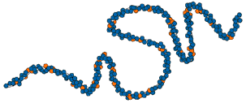
Electron transfer dissociation
Is ETD gentle enough to perform on native proteins?
Sequence + PTMs
3D info?

Slide 21
ETD case study: ADH
Alcohol dehydrogenase: tetramer (147 000 Da)

Slide 22
ETD case study: ADH
Alcohol dehydrogenase: tetramer (147 000 Da)

Slide 23
ETD case study: ADH

Slide 24
ETD case study: ADH
Fragmentation occurs at surface of native tetramer (confirmed through calculations)
Current research: can we extend this to other proteins/complexes?

Slide 25

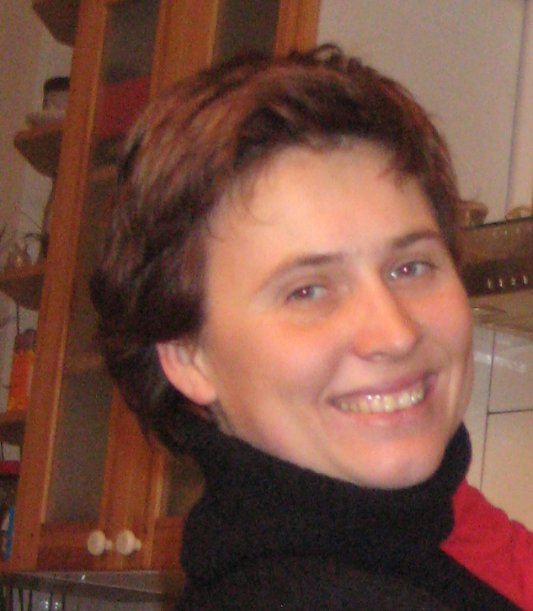
Isotopic distributions in ETD-MS
BIOMOLECULAR MASS SPECTROMETRY group

Slide 26
Isotopic distributions in MS
Elements naturally occur as different isotopes (same # of protons, different # of neutrons)
C: 98.93% ¹²C, 1.07% ¹³C
H: 99.99% ¹H, 0.01% ²H
O: 99.76% ¹⁶O, 0.04% ¹⁷O, 0.20% ¹⁸O
N: 99.63% ¹⁴N, 0.37% ¹⁵N
S: 94.93% ³²S, 0.76% ³³S, 4.29% ³⁴S, 0.02% ³⁶S
Monoisotopic (lightest) peak, M+1, M+2, etc. determined by statistics

Slide 27
Isotopic distributions in MS
1,4-dicyanobenzene (C₈H₄N₂):
chance of M+1 ~ 1 – 0.9893⁸ = 8.2%
I_{M+1}/I_{M} ~ 8.2/98.93 = 8.3%
Monoisotopic peak = most abundant peak
Monoisotopic mass ~ average mass

Slide 28
Isotopic distributions in MS
Small protein (ubiquitin, 76 amino acids, 8.6 kDa):
hundreds of C → monoisotopic no longer most likely
Monoisotopic peak != most abundant peak
Monoisotopic mass !~ average mass

Slide 29
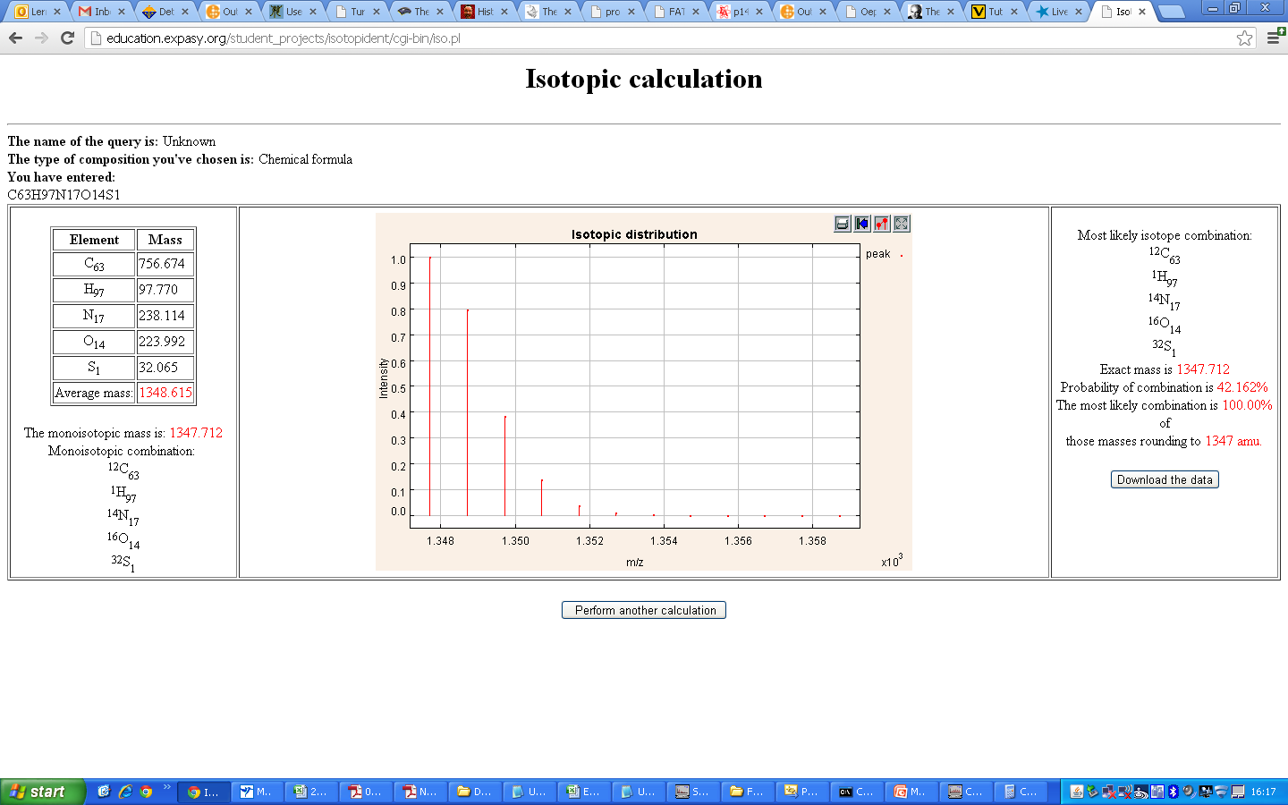
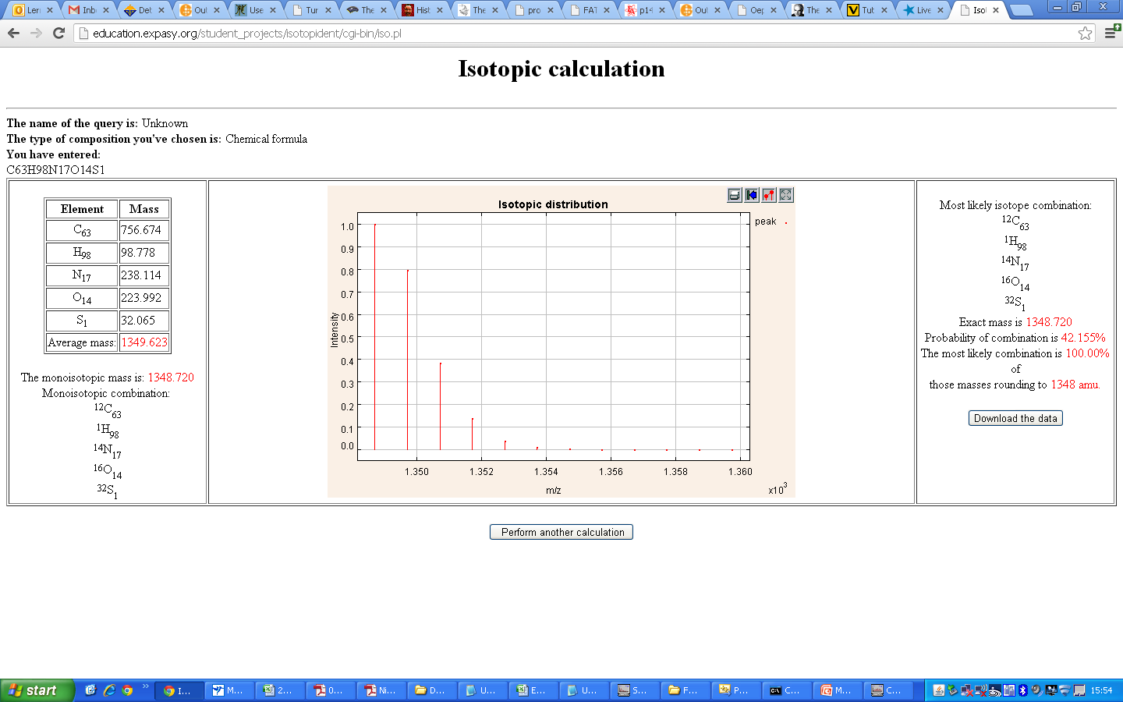

Isotopic distributions in ETD-MS
In ESI-MS: measured mass = M_{protein} + (n x M_{H})
H: 99.99% ¹H → distribution same shape, shifted to the right
Example: substance P (11 amino acids, 1.3 kDa)
Different charge states → appear in different m/z regions
No problem as long as ‘extra’ H are protons H⁺
M + 1H
M + 2H
M + 3H

Slide 30
Isotopic distributions in ETD-MS
ECD/ETD: H⁺ + e⁻ → H. (radical causes fragmentation)
Potential problem!
[M + nH]^{n+} + A.- → [c + xH]^{x+} [z + (n-x)H]^{.(n-x-1)+} + A ETD
[M + nH]^{n+} + A.- → [M + (n-1)H] ^{(n-1)+} + HA PTR
[M + nH]^{n+} + A.- → [M + nH]^{.(n-1)+} + A ETnoD
Contribution (probability) of each reaction not known
Mix of these reactions distorts isotopic distribution
And it gets worse…

Slide 31
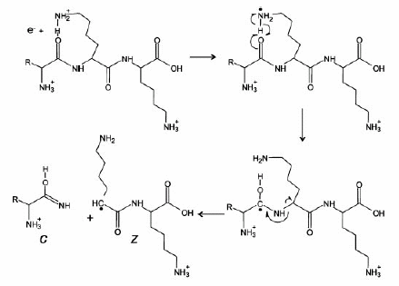
ETD mechanism in detail
1
2
4
3

Slide 32
ETD mechanism in detail
Possible step 5: H. migrates from c to z fragment
[c + xH]^{x+} [z + (n-x)H]^{.(n-x-1)+} + [c + (x-1)H]^{x+} [z + (n-x+1)H]^{.(n-x-1)+}

Slide 33
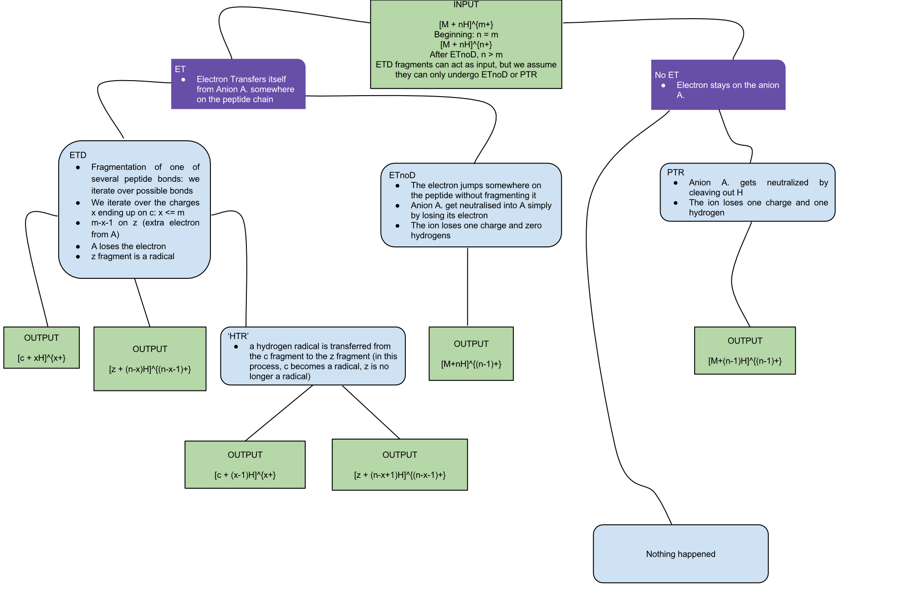
ETD mechanism in detail
So, does this occur in practice?

Slide 34
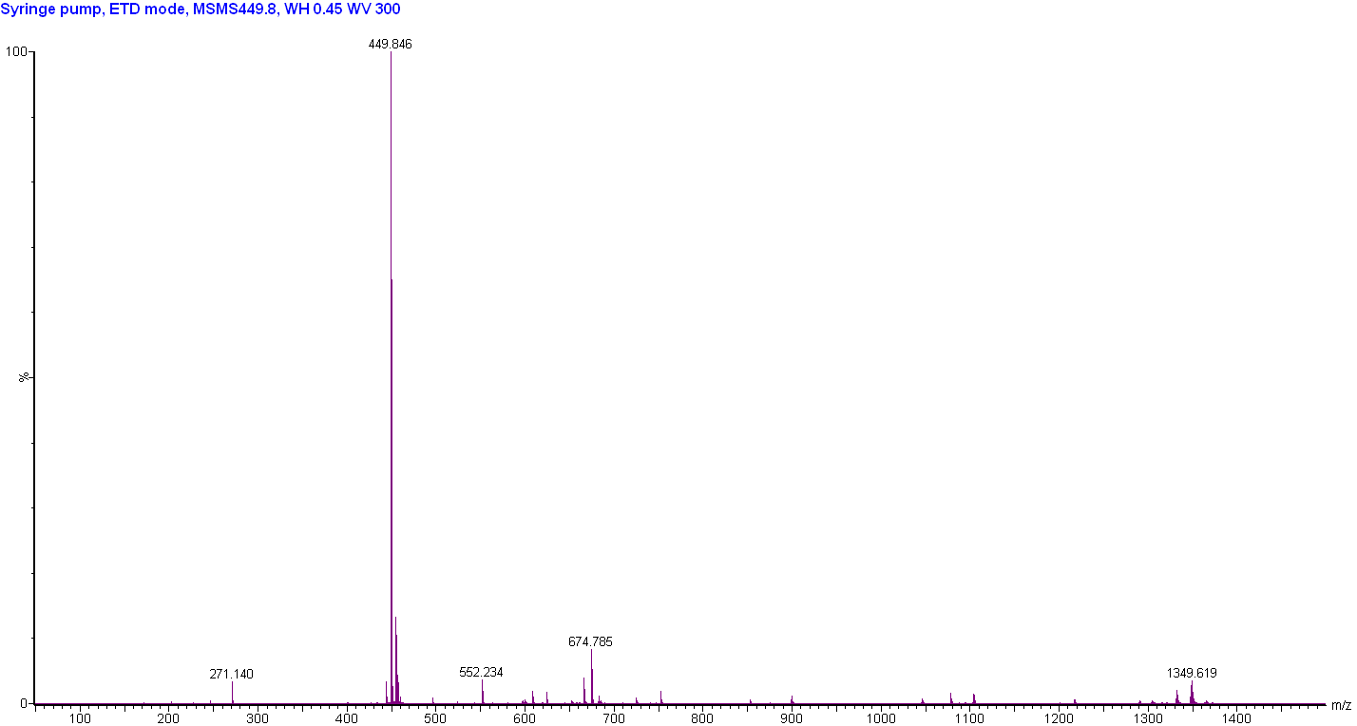
Charge reduction of substance P
PTR or ETnoD? → Look at isotopic distribution
M³⁺
M²⁺
M⁺

Slide 35
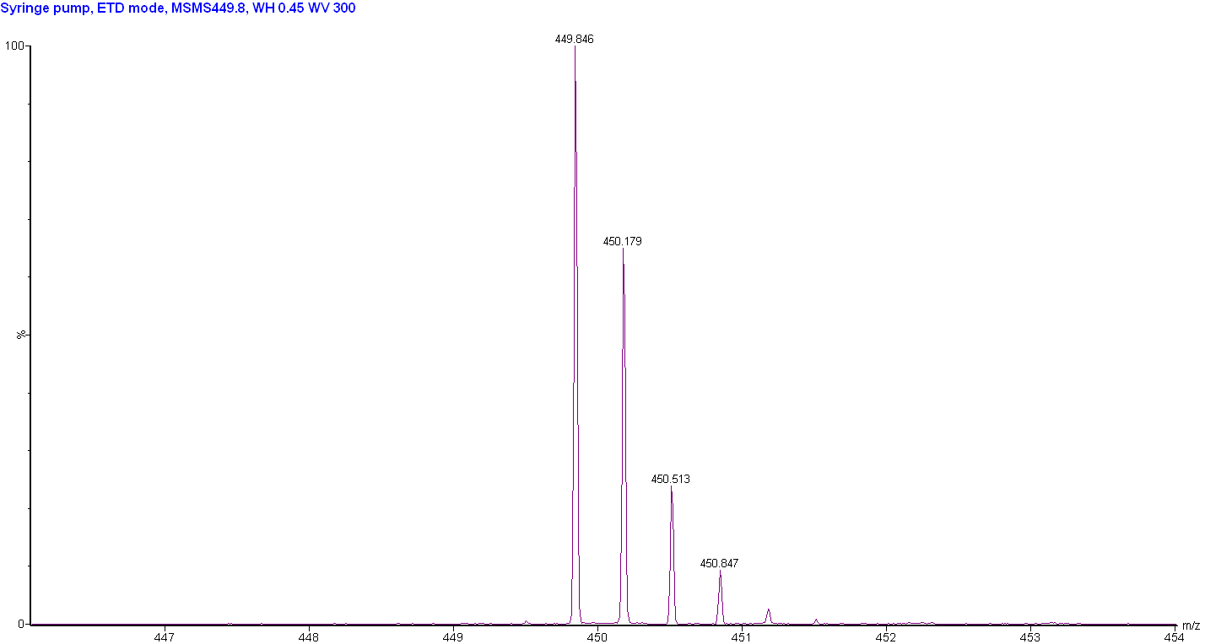
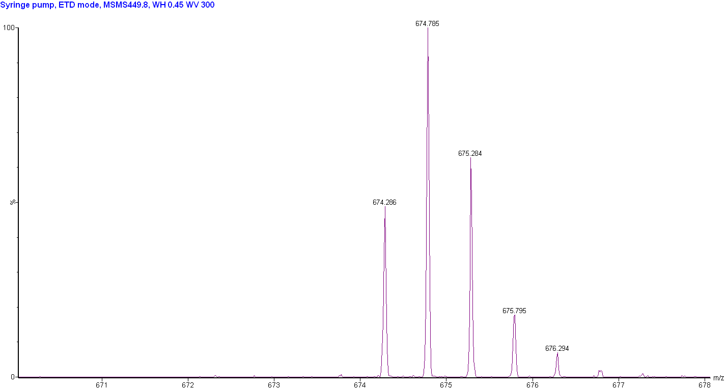
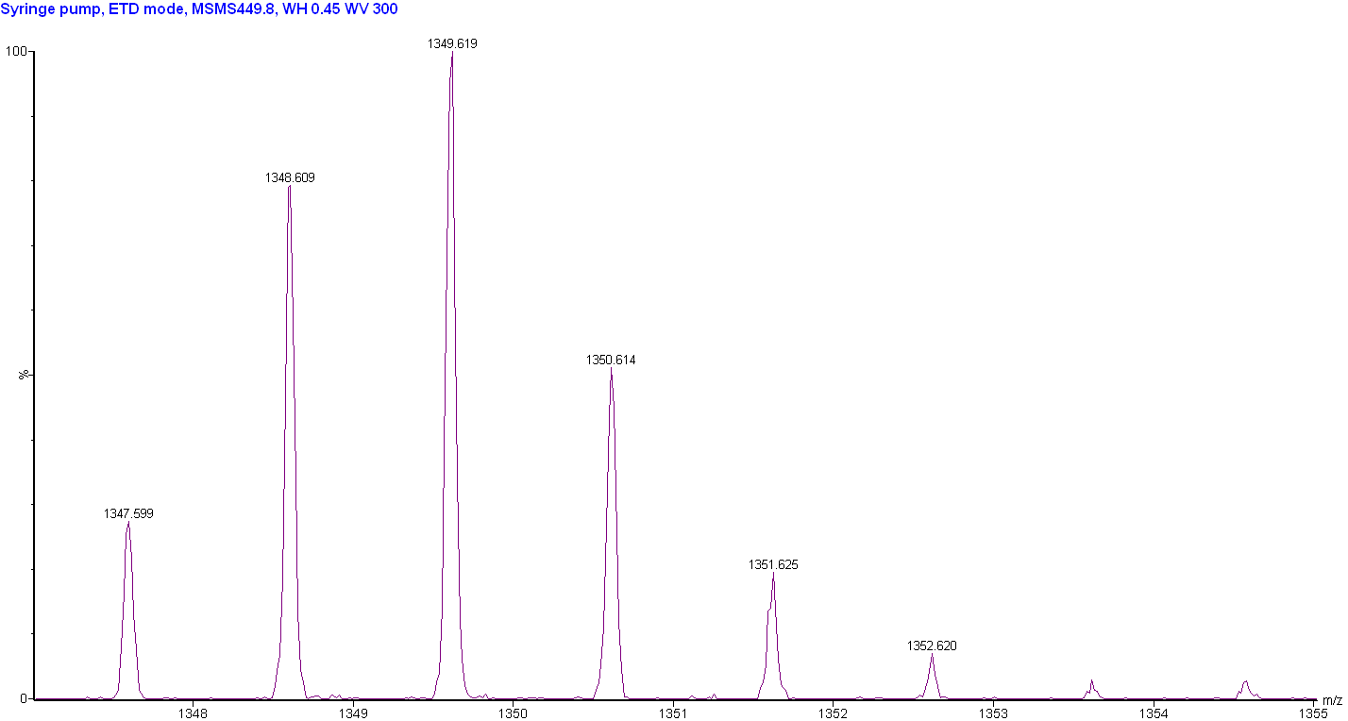
Charge reduction of substance P
M³⁺
M²⁺
M⁺

Slide 36
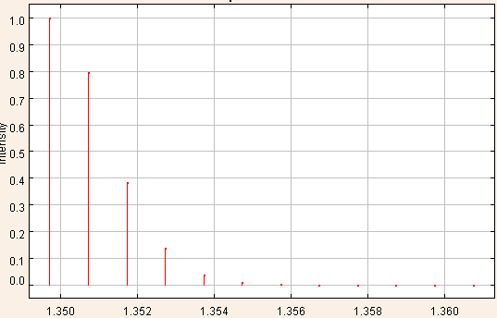
Charge reduction of substance P
M³⁺
M + 3H

Slide 37

Charge reduction of substance P
M²⁺
M + 2H
+
M + 3H

Slide 38
Charge reduction of substance P
M + 1H
M⁺
Both PTR and ETnoD occur!
+
M + 2H
+
M + 3H

Slide 39
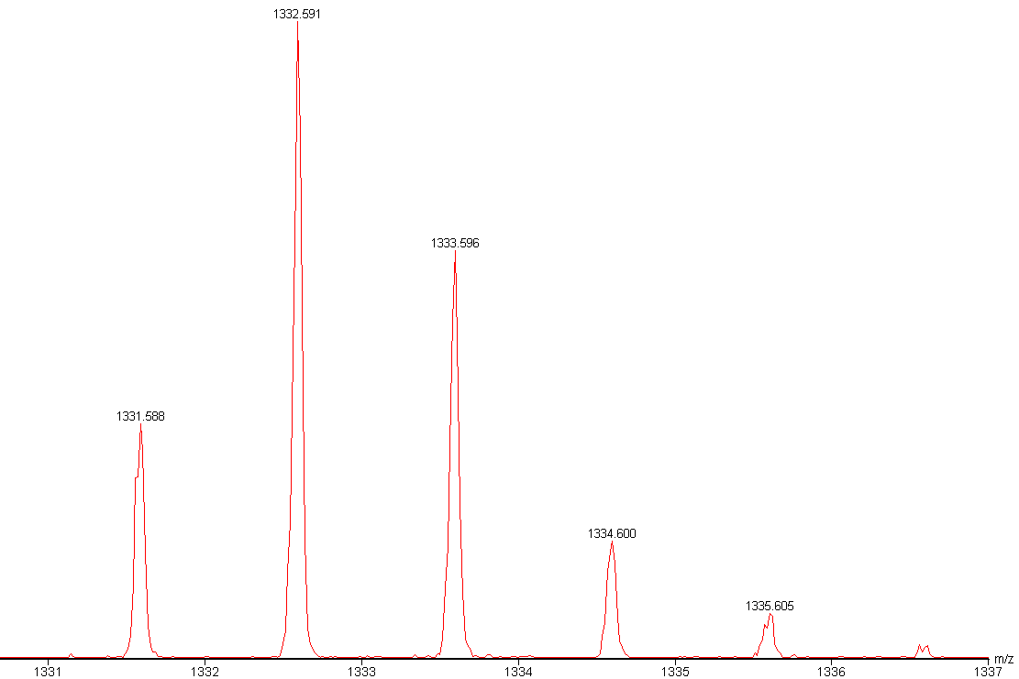

ETD fragmentation of substance P
z₁₁⁺

Slide 40
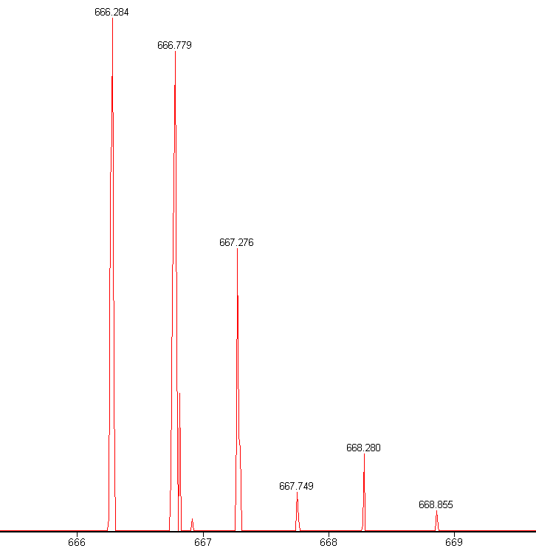
ETD fragmentation of substance P
z₁₁²⁺

Slide 41
Isotopic distributions in ETD-MS
Substance P (1.3 kDa): 3+ precursor used
Maximum of 2 ET steps
Ubiquitin (8.6 kDa): 10 – 12+ precursors often used
ADH tetramer: (147 kDa): 26+ precursor used
Most observed c fragments heavier than expected
…
Can get very complex → bioinformatics required

Slide 42
Goals of the project
Deconvolute observed isotopic distributions and determine contribution of each component
Learn how important each of the possible reactions is and gain insight into the (multistep) ETD process
Peak assignment, e.g.
=
α
+
β

